Slide 1
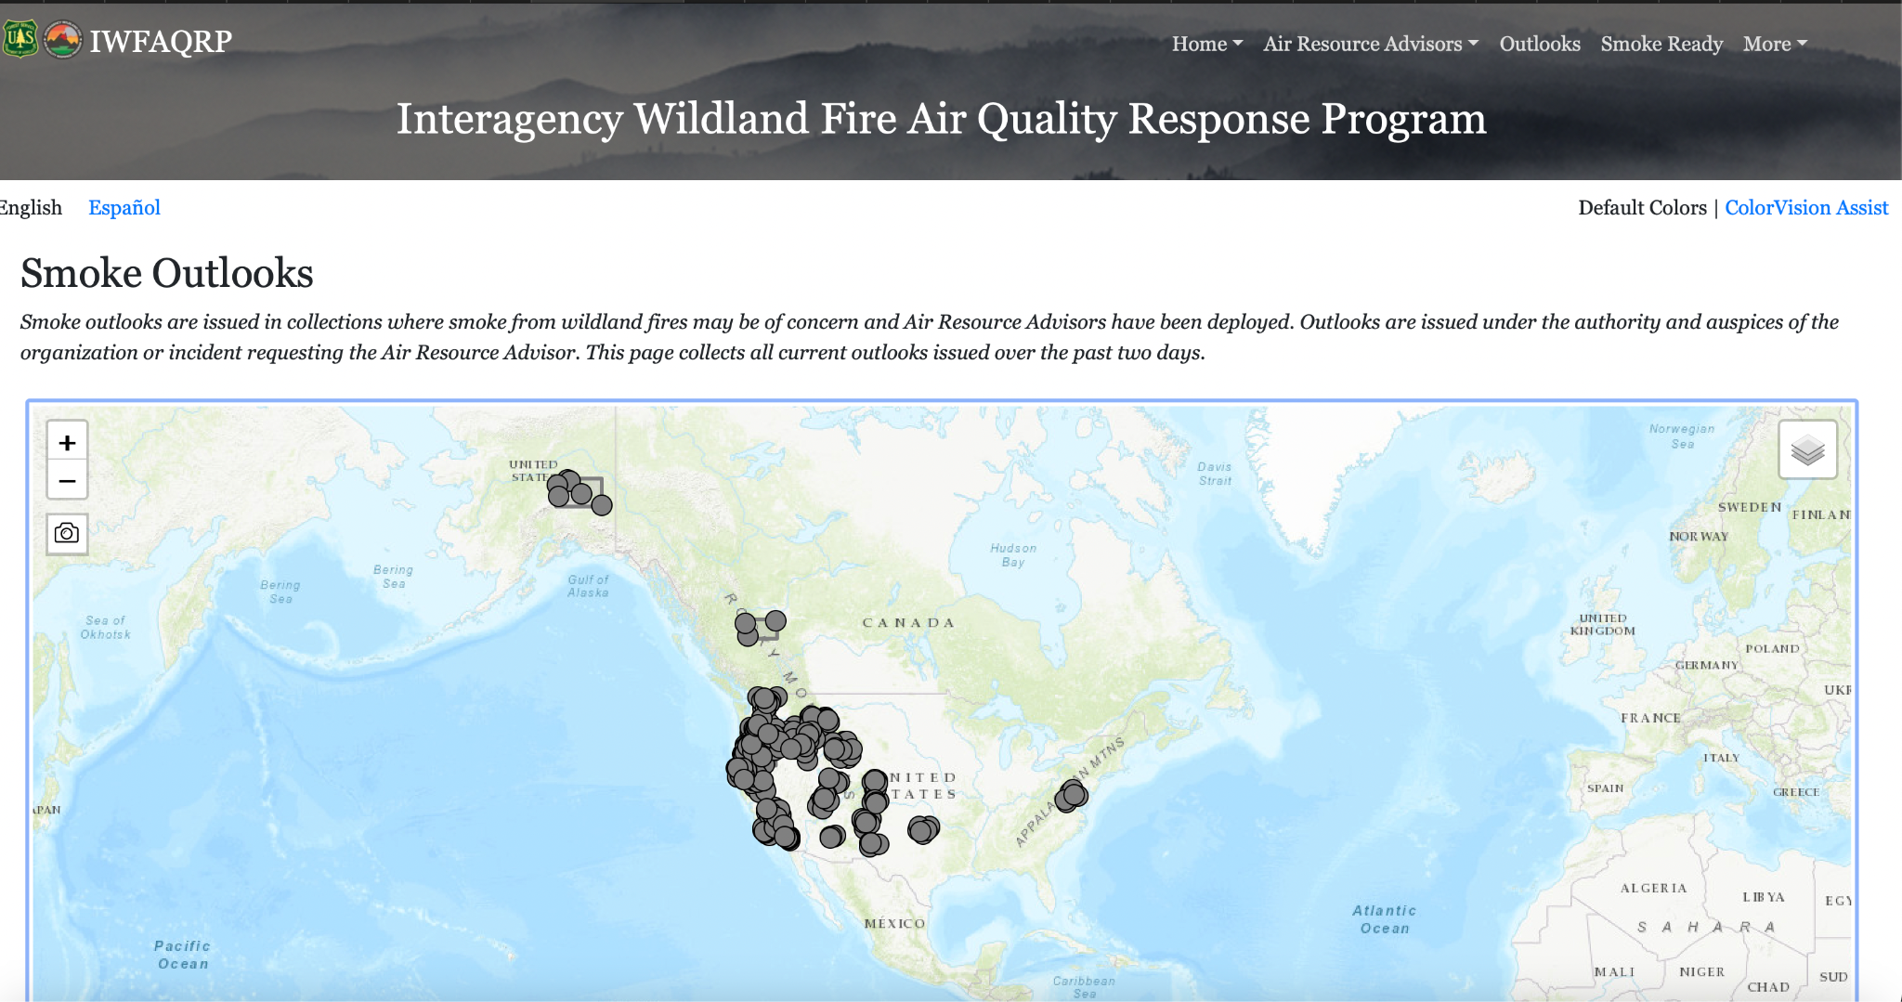
Smoke Outlook Translation Model
Bridging the gap in wildfire smoke forecasts for Spanish-speaking communities.
Group Firebot🔥
Samuel D. Ryan, Agampreet Singh, Frankie Roberts, Yiyu Chen, Aparajita Pathak

Slide 2
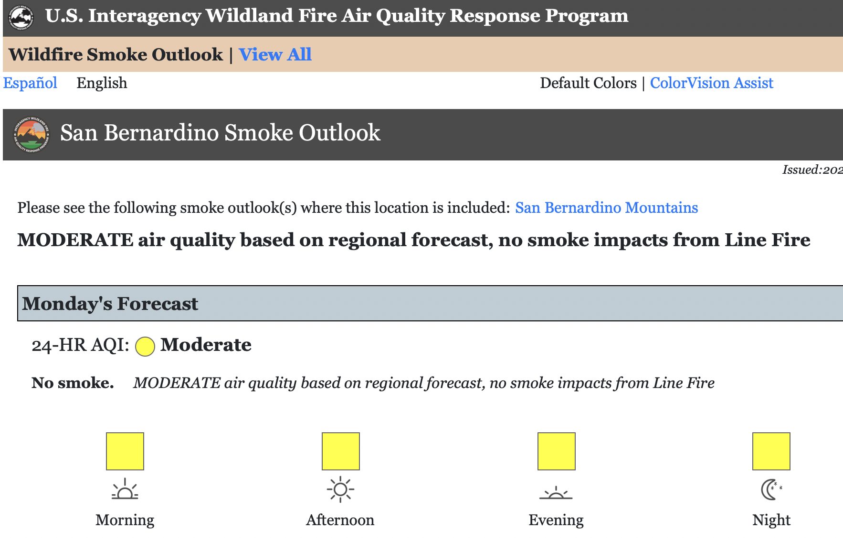
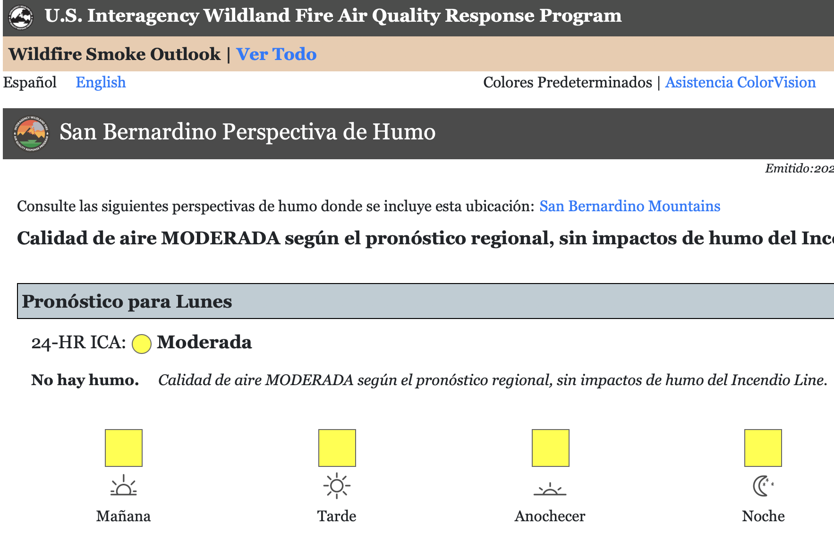
Motivation for the Project
Wildfire smoke forecasts are essential for public safety.
Many Spanish-speaking communities lack clear, reliable translations.
Misinformation or unclear forecasts can put lives at risk.
English Outlook
Spanish Translation

Slide 3

Why This Matters
Accurate translations ensure timely health & safety decisions.
Promotes accurate internal functioning with quick turnaround time to spread information
Supports environmental justice for vulnerable populations.
Pasadena Fire 2025

Slide 4
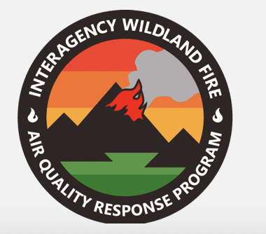
Project Sponsor
Sponsored by USFS AirFire
an organization specializing in wildfire smoke forecasting & air quality modeling.
Collaboration ensures scientific accuracy in translations and removes manual overhead by automating this process.
http://renewmentcounseling.com/i-did-not-have-a-choice/

Slide 5
Our Team’s Interest
As Information Management students, we work with data while considering ethics & privacy.
This project is an opportunity to apply our responsible AI learnings in a real world setting.
We’re excited to use data driven solutions to create inclusive, community-focused technology.

Slide 6
Initial Challenges
Budget constraints ~$100
Delay in API Key
API: application programming interface
How software talk to each other
Cleaning data of duplicates and complete pairs

Slide 7
Key Milestones Achieved
Set MVP goals
Recurring meeting with sponsor
Established workflows and tasks for each member
Development
Testing/training
Admin/documents master

Slide 8
Understanding the “Stack”
Javascript (JS) | Code that allows webpages interactive
Node.js | Allows JS code to run locally on a computer
NPM | Manages packages for Node
Express.js | A node package that manages and routes servers

Slide 9
Understanding the “Stack”
ChatGPT API | Service from OpenAI in which different models can be accessed contingent on payment per usage
Github | Platform to implement version control on any repository stored there

Slide 10
Development Setup
Set up working branches in Github
Installed required Node packages
Created special files to document notes and learning process
Training and grading the ChatGPT model

Slide 11
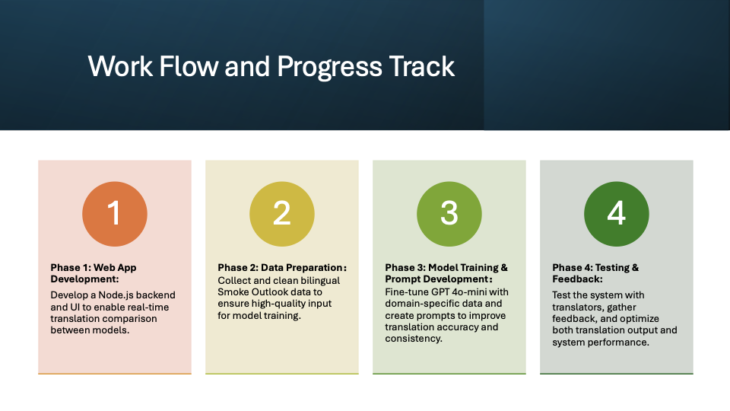

Slide 12
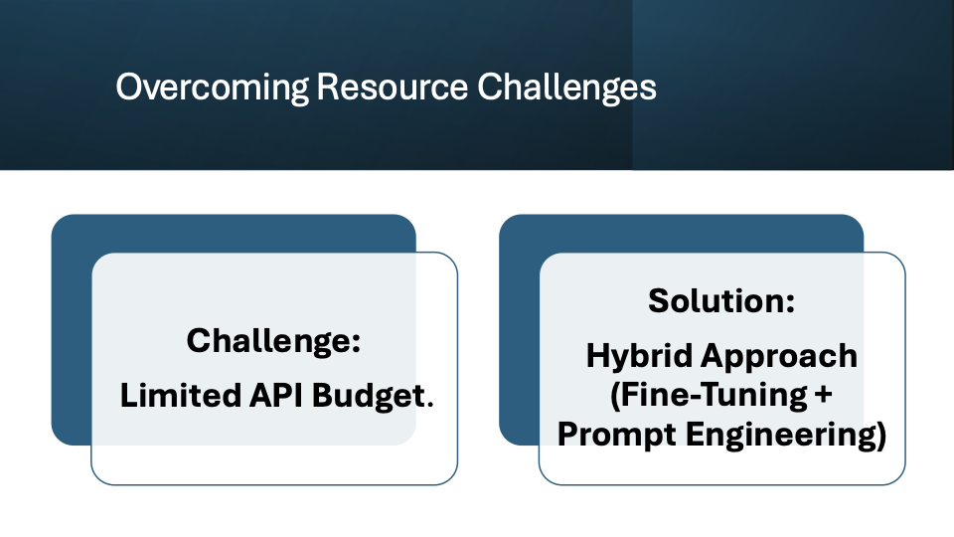
Notes:
We only has $200 for the entire project.
A full fine-tuning process, combined with large-scale API calls, would likely exceed this budget.
And also fine-tuninged Model cost more usage (tokens for input, prompt, and completion) than normal model.
Solution: Hybrid Approach (Fine-Tuning + Prompt Engineering)
Efficient Resource Allocation:
Instead of fully relying on fine-tuning, we optimized costs by balancing fine-tuning with prompt engineering.
Steps Taken:
Performed small-scale fine-tuning with a limited dataset (~1000 bilingual translation pairs).
Created tailored prompts to improve translation quality without the need for extensive retraining.
Reduced prompt length after fine-tuning, lowering API token consumption during translation tasks.

Slide 13
Current Status
Deliverable | Description | Status
Initial Documentation & Guide | Document and describe steps taken | Complete
Data Acquisition | Collect historical data for model training | Complete
OpenAI Token Balance Management | $200 balance for API usage | Complete
Model Selection | Choosing between GPT 3.5, 4o, o1, and o3 mini | On Track
http://newvaluestreams.com/wordpress/wp-content/uploads/2009/08/navigating.jpg

Slide 14
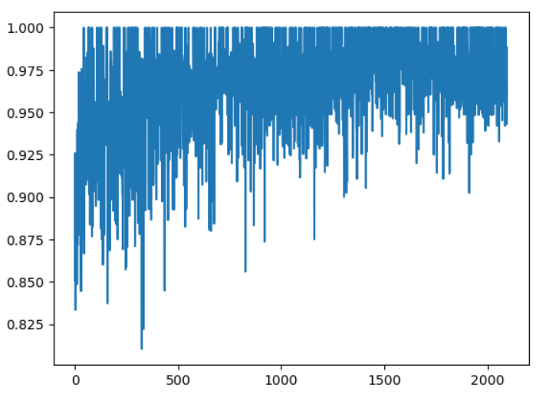
Next Steps
Confirm Model Selection
Integrate Additional Training Data
Provide Step-By-Step Methodology
Tune Evaluation Metrics
http://newvaluestreams.com/wordpress/wp-content/uploads/2009/08/navigating.jpg

Slide 15
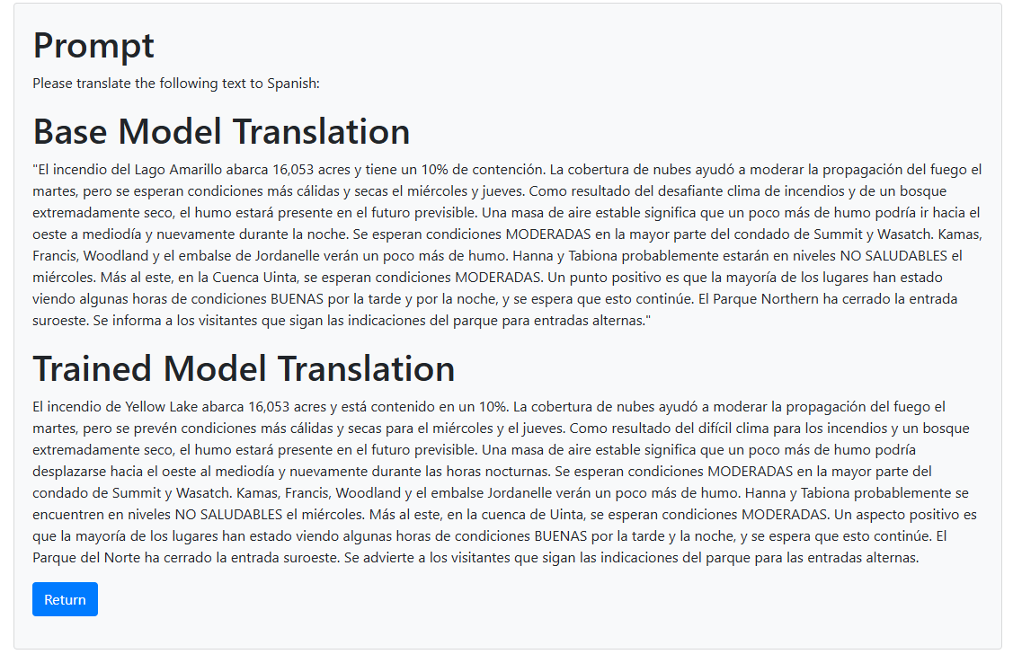
User Interface Progress
http://newvaluestreams.com/wordpress/wp-content/uploads/2009/08/navigating.jpg

Slide 16



Sponsor Engagement

Slide 17

Feedback & Improvement
Translator feedback will help refine model accuracy and improve output quality

Slide 18
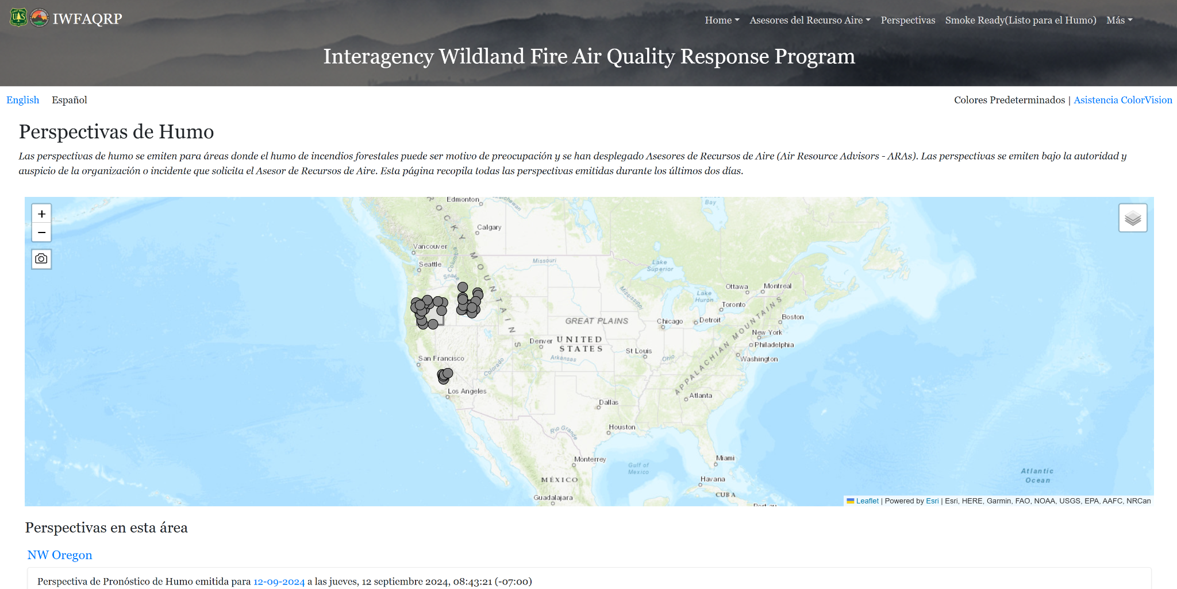
Expected Outcomes

Slide 19

Broader Impact
This project lays the foundation for more AI-driven language accessibility efforts

Slide 20
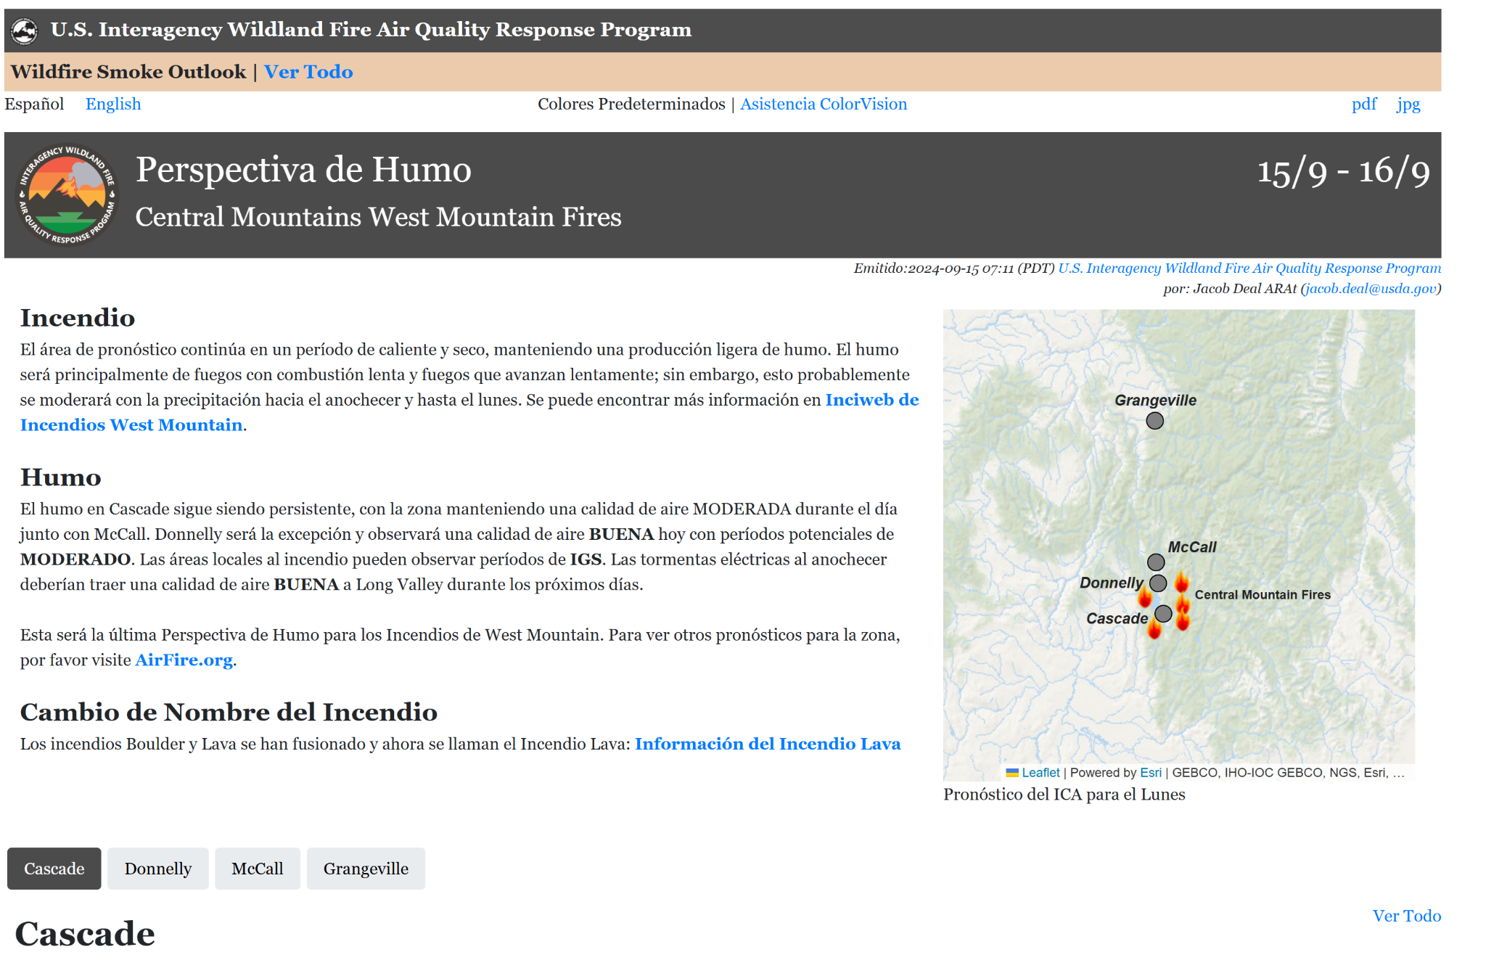
Closing Thoughts

